Slide 1
Au & Az, SSO
Back to Basics
By PuGong

Slide 2
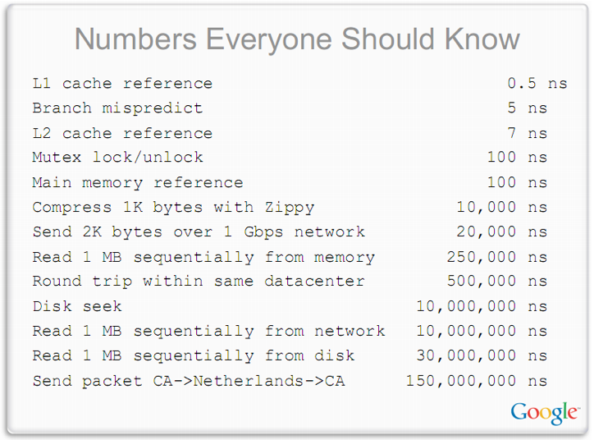

Slide 3
List
Product / Develop / Operation
Software lifecycle
ITIL
Source Control
Evolution of A Website’s Architecture
AuAz & SSO
Cache
Message Queue
Storage
Database and SQL
NoSQL & New SQL
TOGAF & 4+1 Arch View
测试
发布
监控

Slide 4
Authentication
A process of verifying that "you are who you say you are”.
Parts:
Query for credentials
Verify Credentials
Method：
Form Authentication
AD／LDAP Authentication
Sign, Fingerprint
Factual verification
Two Factor Authentication
SSO: OAuth, OpenID, SAML etc
Security, Security, Security

Slide 5
Authorization
A process of verifying that "you are permitted to do what you are trying to do”
Method:
RBAC
ACL: most file system: Read, Write, eXecute
Principle of least privilege

Slide 6
SSO
Single sign-on is a user/session authentication process that permits a user to enter one name and password in order to access multiple applications. The process authenticates the user for all the applications they have been given rights to and eliminates further prompts when they switch applications during a particular session.
Web SSO

Slide 7

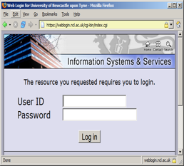
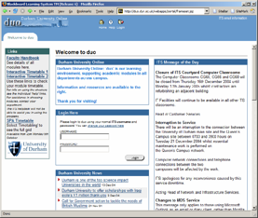
Authentication Center
Application
1
Visit protected
resources
2
3
Redirect to
Auth Page
Auth Info redirect
back to Vendor
4
API call
Validate Token

Slide 8
Advantages
用户(角色)统一管理
降低运营和管理成本
提升用户体验
减轻开发人员的复杂
增强系统安全性
多种认证方式
Smartcards
Security token
记录登录信息
满足安全审计要求 (SOX, HIPAA)

Slide 9
Criticisms
成为企业关键应用，存在单点故障风险
系统被攻破或者系统不严谨导致SSO下所有应用都被暴露
SSO安全报告 by Rui Wang, Shuo Chen和XiaoFeng Wang，研究googleId, paypal Access, facebook等，找到数个严重逻辑错误

Slide 10
Implementations
Mechanism
Cookie
Token/Ticket
SAML 安全断言
Kerberos 代理人
Gateway
Products
CAS
SAML
Facebook connect
IBM TAM ／Windows Live Id
OAuth
Open Id (Google ID, Paypal Access)
CA SiteMinder

Slide 11
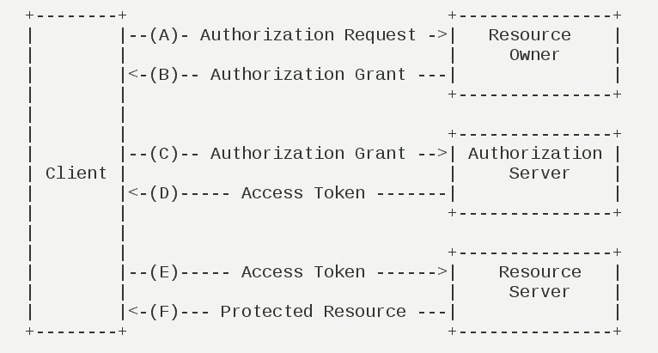
OAuth

Slide 12
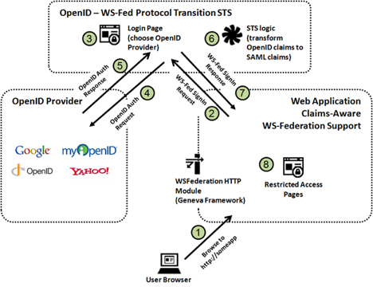
Open Id
以用户为中心的数字身份识别框架

Slide 13
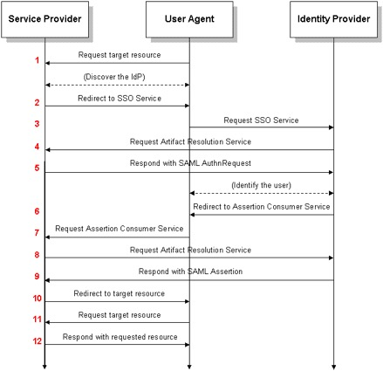
SAML
Security Assertion Markup Language
Standard of OASIS (SOAP, UDDI)
实现：Shibboleth

Slide 14
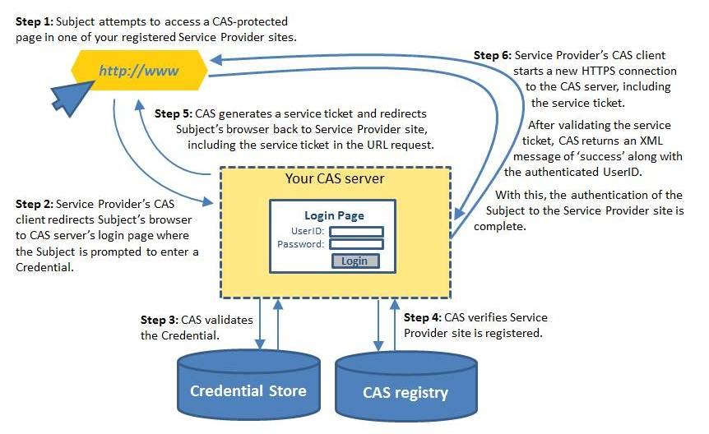
CAS

Slide 15
References
OAuth: http://oauth.net/2/
Open Id: http://openid.net/
http://en.wikipedia.org/wiki/Single_sign-on
http://en.wikipedia.org/wiki/List_of_single_sign-on_implementations
http://en.wikipedia.org/wiki/Central_Authentication_Service
http://en.wikipedia.org/wiki/SAML_2.0
http://sso-analysis.org/

